Slide 1
The impact of computer usage on academic performance: Evidence from a randomized trial at the United States Military Academy
Susan Payne Carter, Kyle Greenberg, Michael S. Walker
Discussion by Jeff Denning

Slide 2
What is the question?
How does allowing laptops in the classroom affect student performance?
What’s the broadest way to frame this question?
What’s the narrowest way to frame the question?

Slide 3
Setting
United State Military Academy (West Point)
Small, liberal arts college
Introductory Economics (sophomore year)
Everyone is on “scholarship” but must serve in the military for 5 years active duty and 8 years total.

Slide 4
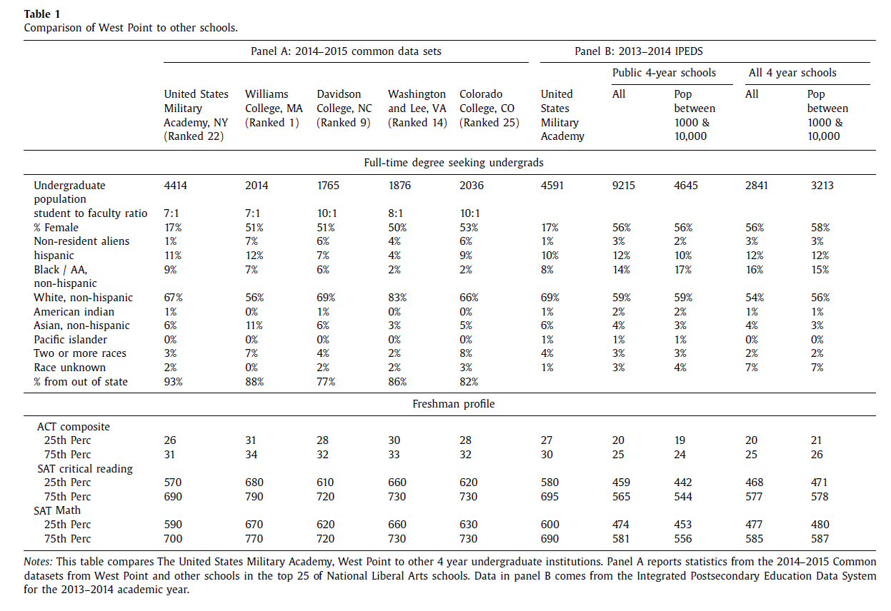
Why do they have Table 1?

Slide 5
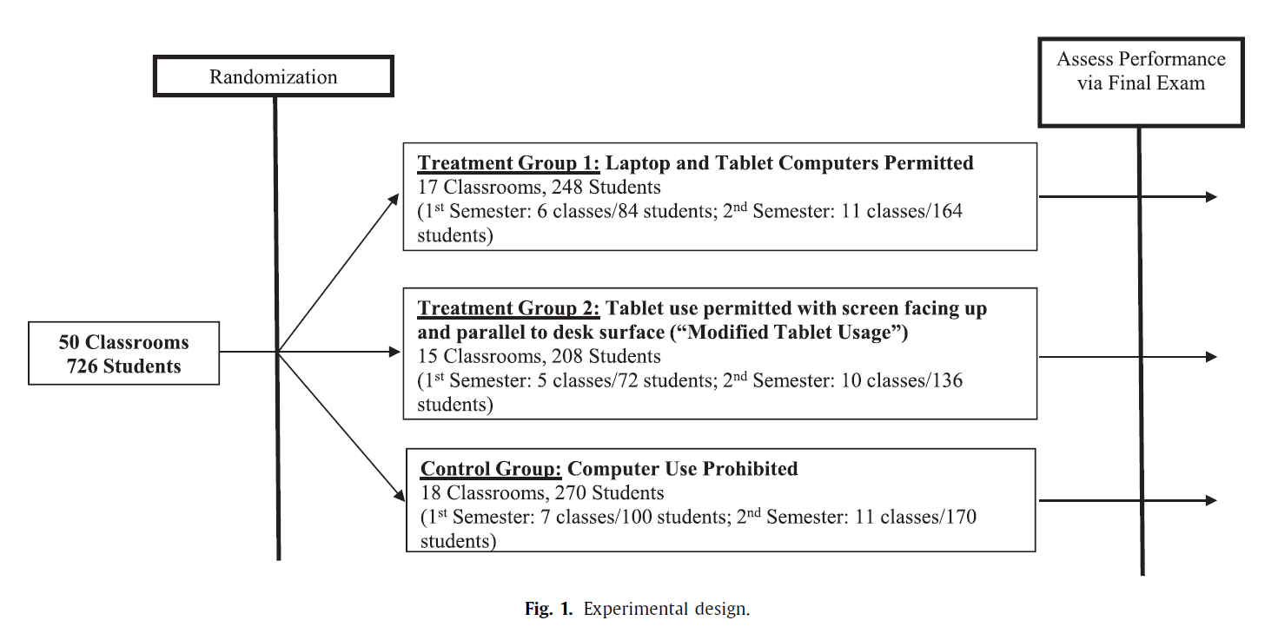
Experiment

Slide 6
What about SUTVA?
Do we need to worry about SUTVA here?
What if they randomized at the student level?

Slide 7
Notes on West Point
Small classrooms
Identical syllabus
Same textbook
Online testing
Up to 30 sections of the course, taught by 10 different professors
No cell phones
Students are randomly assigned to classes. Is this necessary for a causal interpretation?
Grades (mechanically) matter for your first job
Everyone has a laptop and tablet, wifi, and has taken a CS course.

Slide 8

Estimating equation
These are a bit fancier than is ideal for your first RCT
Y is an outcome, i is a student, j is professor, class-hour is h, and semester is t.
Z is an indicator for treatment (it doesn’t have i, why?)
Kappa are professor/semester fixed effects (what kind of comparison does this mean we make)
Lambda includes fixed effects for class hour and semester

Slide 9
Data
50 classrooms, 726 students
Limit to sophomores
Survey of faculty
Administrative data from school
Final Exam
Some section was scored by machines. Others were scored by the professors.
Why does this distinction matter?
Small attrition, and not differential by treatment (2%). Why does this matter?

Slide 10
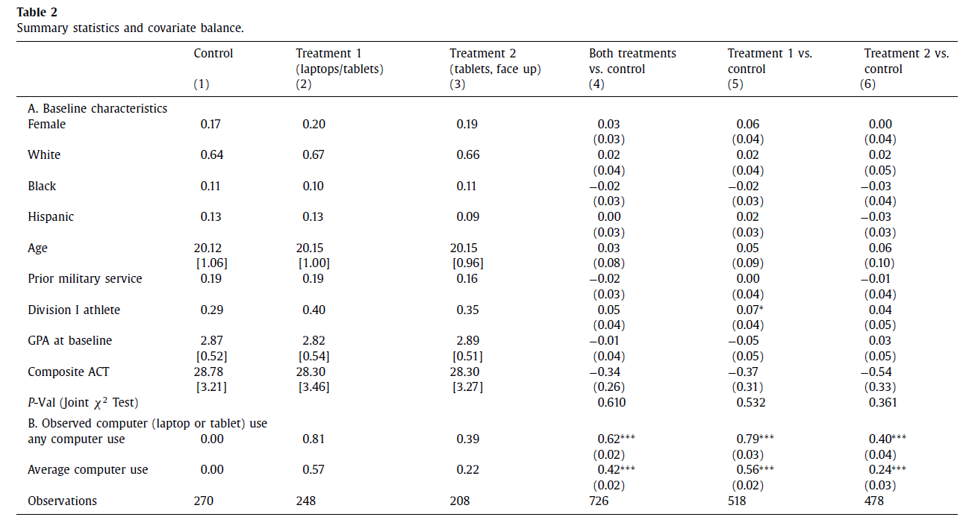
Did Randomization Work? Did this treatment matter?

Slide 11
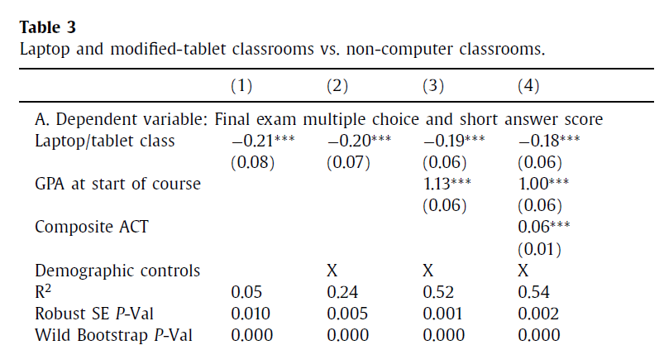
What’s the answer?

Slide 12
Laptops/Tablets were bad for students
Driven by multiple choice/short answers
Effects are pretty big, .2 of a standard deviation.
17% as large as a 1 point increase in GPA

Slide 13
Is this result driven by Tablets or Computers
Both!
The effects are remarkably similar
The authors comment that they can’t rule out too much when it comes to laptops versus computers.

Slide 14
Other things they do
Some students have a test of economics they took before the semester. They control for this and find similar results. Is this necessary?
Worry a lot about standard errors

Slide 15
Internally Valid?
How does this paper do on internal validity?

Slide 16
Internally Valid?
How does this paper do on internal validity?
Pretty well
Low attrition
Adherence to treatment seems good
Extra levels of randomization
Checks for balance
Even on a pre-test!

Slide 17
How does this do on external validity?
Where are these results likely to apply?

Slide 18
How does this do on external validity?
Where are these results likely to apply?
More likely to apply in smaller classrooms, liberal arts colleges, selective institutions, econ classes
Likely doesn’t apply as closely to CS classes

Slide 19
What do we learn?
Laptops aren’t good for student learning in econ classes
What should we do?
If you were teaching an econ class, what would you do about laptops?
What is this a question of?
What if you were teaching a PA class?

